Slide 1
School of Computer Science and Engineering
Data Mining and Data Warehouse

Slide 2
Syllabus: Module 1
Data Warehouse: Basic Concepts,
Differences between Operational Database Systems and DW
A Multi-tiered Architecture
Data Warehouse Models
Extraction, Transformation, and Loading
Metadata Repository
Data Cube and OLAP
Data Warehouse Design and Usage
Data warehouse implementation.

Slide 3
Data warehouses and OLAP tools are based on a multidimensional data model. This model views data in the form of a data cube. Now we will learn how data cubes model n-dimensional data

Slide 4
Data Warehouse Modeling:
A Multidimensional Data Model
Data Cube:
2D data cube
3D data cube
4D data Cube
Lattice
Schemas:
Star
Snowflake
Fact constellation

Slide 5
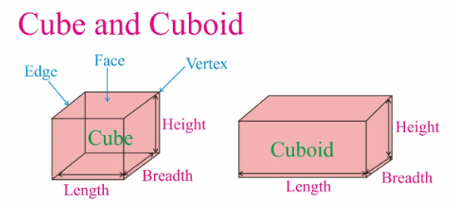
Data cube
A data cube allows data to be modeled and viewed in multiple dimensions. It is defined by dimensions and facts.

Slide 6
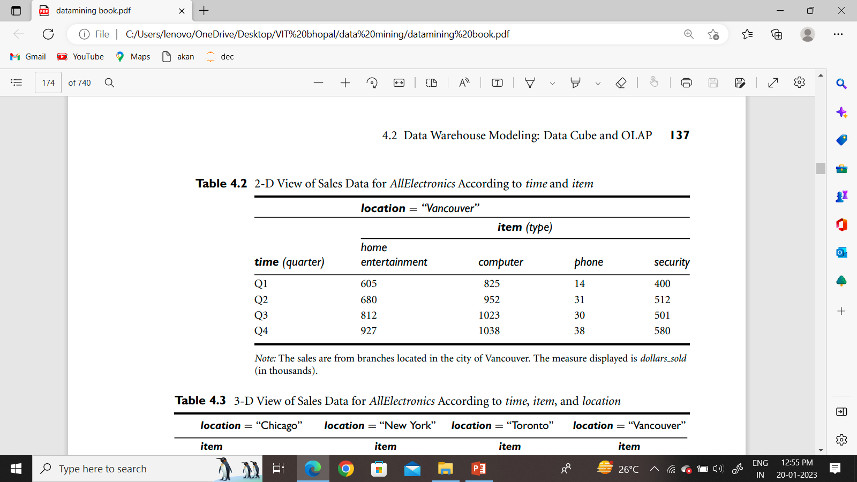
2 D View of Data

Slide 7
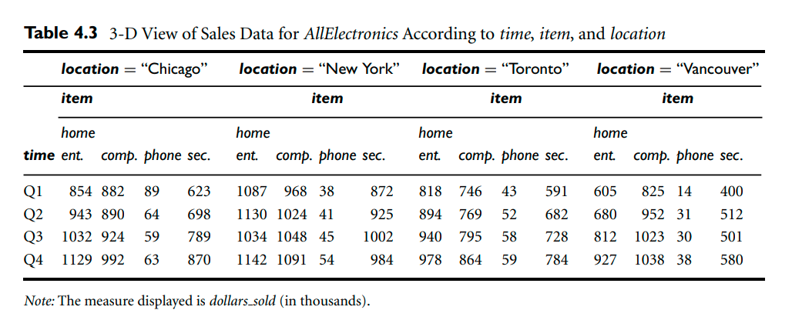
Tables 4.2 and 4.3 show the data at different degrees of summarization
3 D View of Data

Slide 8
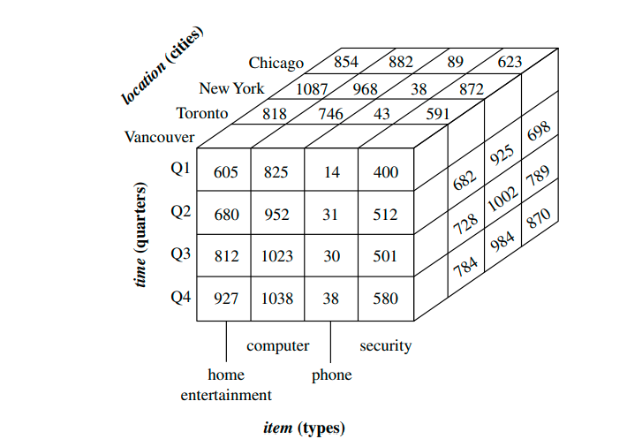
Data Cube (3D View)

Slide 9
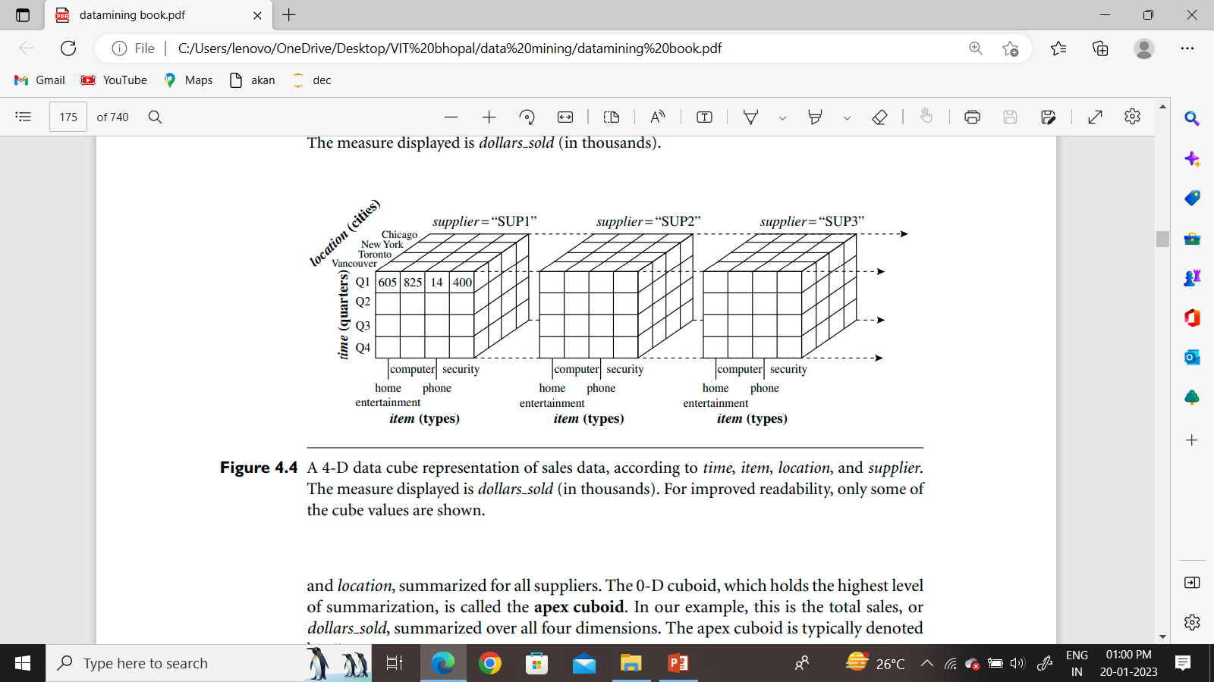
4-D View of Data
Figures 4.3 and 4.4 is often referred to as a cuboid.

Slide 10
Lattice of Cuboid
we can generate a cuboid for each of the possible subsets of the given dimensions.
The result would form a lattice of cuboids, each showing the data at a different level of summarization, or group-by. The lattice of cuboids is then referred to as a data cube. Figure 4.5 shows a lattice of cuboids forming a data cube for the dimensions time, item, location, and supplier.

Slide 11
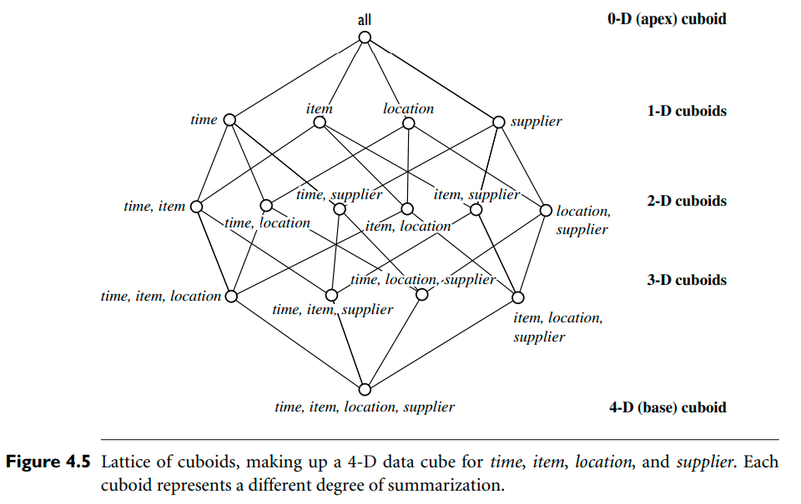
Lattice of Cuboid

Slide 12
Lattice of Cuboid
The cuboid that holds the lowest level of summarization is called the base cuboid. For example, the 4-D cuboid in Figure 4.4 is the base cuboid for the given time, item, location, and supplier dimensions. Figure 4.3 is a 3-D (nonbase) cuboid for time, item, and location, summarized for all suppliers. The 0-D cuboid, which holds the highest level of summarization, is called the apex cuboid. In our example, this is the total sales, or dollars sold, summarized over all four dimensions. The apex cuboid is typically denoted by all.

Slide 13
Schemas for Multidimensional Data Models
The entity-relationship data model is commonly used in the design of relational databases, where a database schema consists of a set of entities and the relationships between them. Such a data model is appropriate for online transaction processing.
Cube in dataware house
each dimension (item, location, time) may have a table associated with it, called a dimension table, which further describes the dimension.
For example, a dimension table for item may contain the attributes item name, brand, and type.
Dimension tables can be specified by users or experts.
A multidimensional data model is typically organized around a central theme, such as sales. This theme is represented by a fact table. Facts are numeric measures

Slide 14
Star schema:
The most common modeling paradigm is the star schema, in which the data warehouse contains
(1) a large central table (fact table) containing the bulk of the data, with no redundancy, and
(2) a set of smaller attendant tables (dimension tables), one for each dimension.
The schema graph resembles a starburst, with dimension tables.

Slide 15
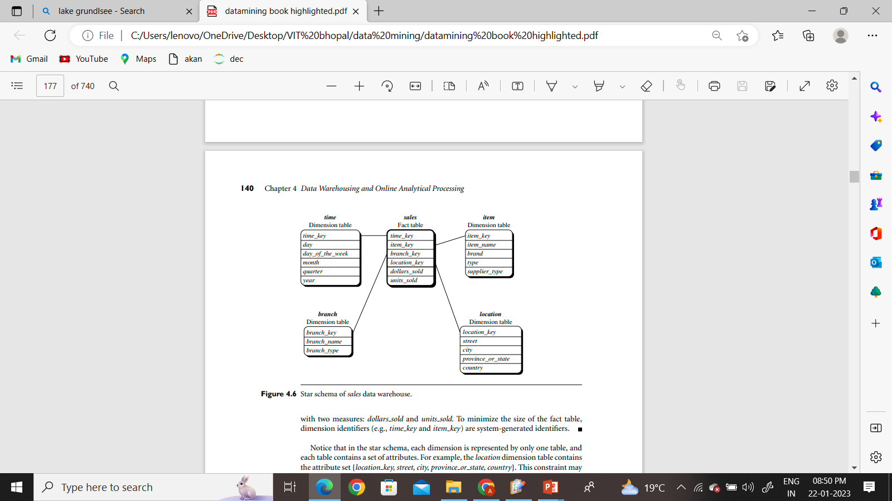
Example: The schema contains Four dimensions: time, item, branch, and location. a central fact table for sales that contain keys to each of the four dimensions and some features.
Star schema:

Slide 16


Snowflake schema:
The major difference between the snowflake and star schema models is that the dimension tables of the snowflake model may be kept in the normalized form to reduce redundancies. Such a table is easy to maintain and saves storage space. However, this space savings is negligible in comparison to the typical magnitude of the fact table. Furthermore, the snowflake structure can reduce the effectiveness of browsing, since more joins will be needed to execute a query. Consequently, the system performance may be adversely impacted. Hence, although the snowflake schema reduces redundancy, it is not as popular as the star schema in data warehouse design.

Slide 17
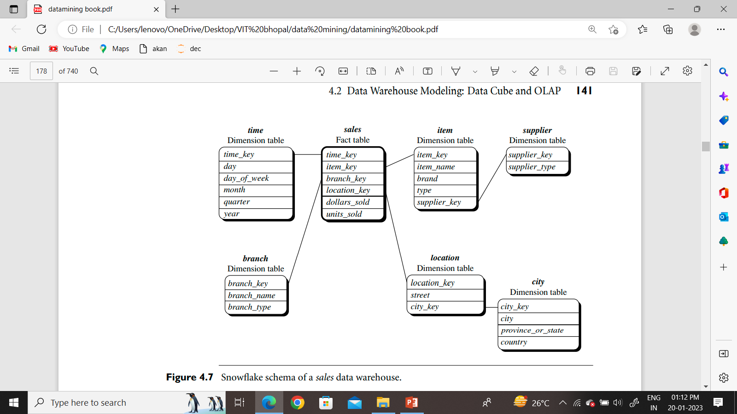
Snowflake schema:

Slide 18
Sophisticated applications may require multiple fact tables to share dimension tables. This kind of schema can be viewed as a collection of stars, and hence is called a galaxy schema or a fact constellation. dimension tables to be shared between fact tables. For example, the dimensions tables for time, item, and location are shared between the sales and shipping fact tables.
Fact constellation:

Slide 19
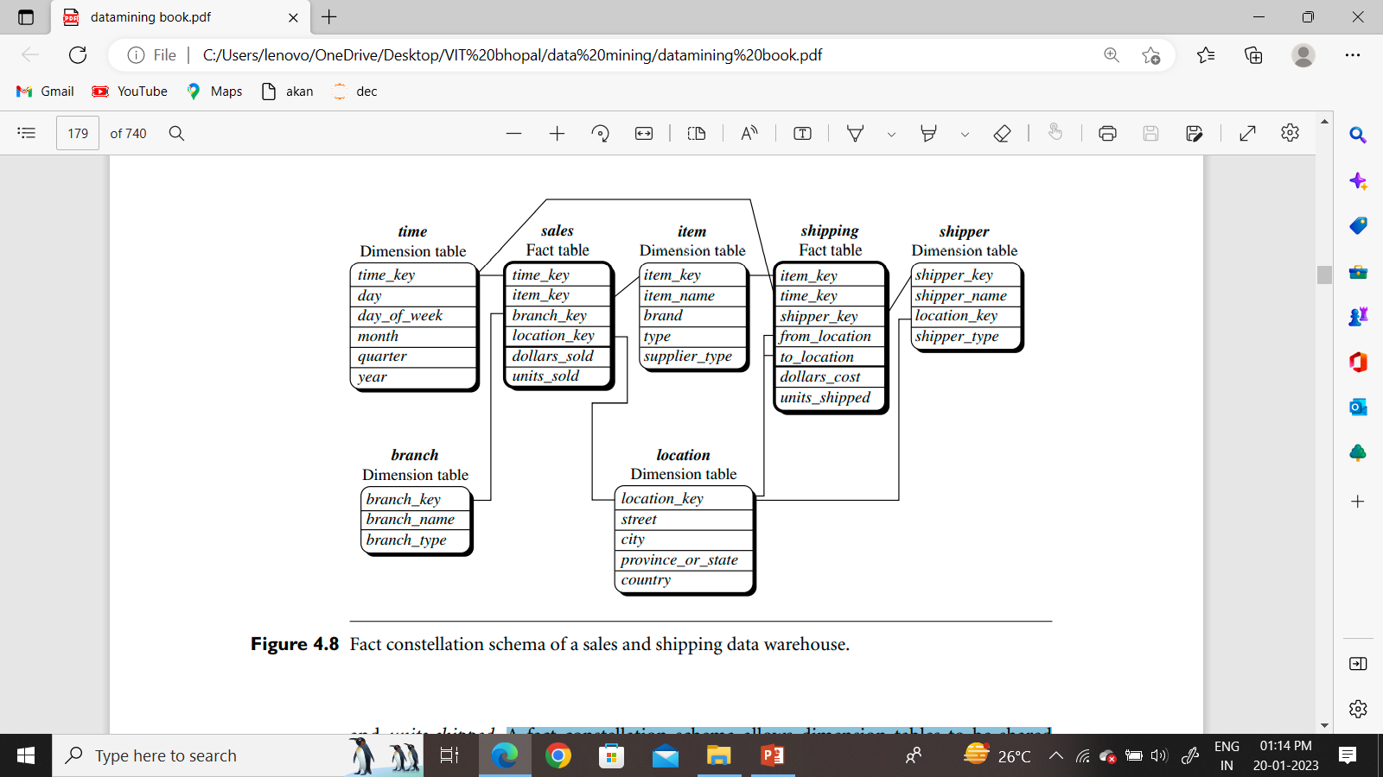
Fact constellation:

Slide 20
Concept Hierarchies
A concept hierarchy defines a sequence of mappings from a set of low-level concepts to higher-level or more general concepts. Consider a concept hierarchy for the dimension location.
India
MP
UP
Bhopal
Indore
Many concept hierarchies are implicit within the database schema. For example, suppose that the dimension location is described by the attributes number, street, city, state, and country.
MP Nagar
New Market

Slide 21
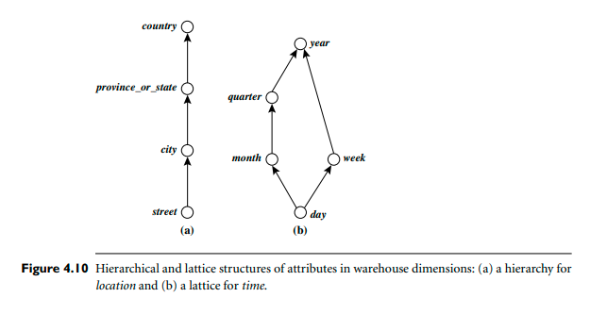
Concept Hierarchies
Hierarchical and lattice structures of attributes in warehouse dimensions:
Hierarchy such as “street < city < state < country.
The attributes of a dimension maybe organized in a partial order, forming a lattice. An example of a partial order for the time dimension based on the attributes day, week, month, quarter, and year is “day < {month < quarter; week} < year.”1

Slide 22
Typical OLAP Operations
In the multidimensional model, data are organized into multiple dimensions, and each dimension contains multiple levels of abstraction defined by concept hierarchies.
This organization provides users with the flexibility to view data from different perspectives.
A number of OLAP data cube operations exist to materialize these different views, allowing interactive querying and analysis of the data at hand.
Hence, OLAP provides a user-friendly environment for interactive data analysis

Slide 23
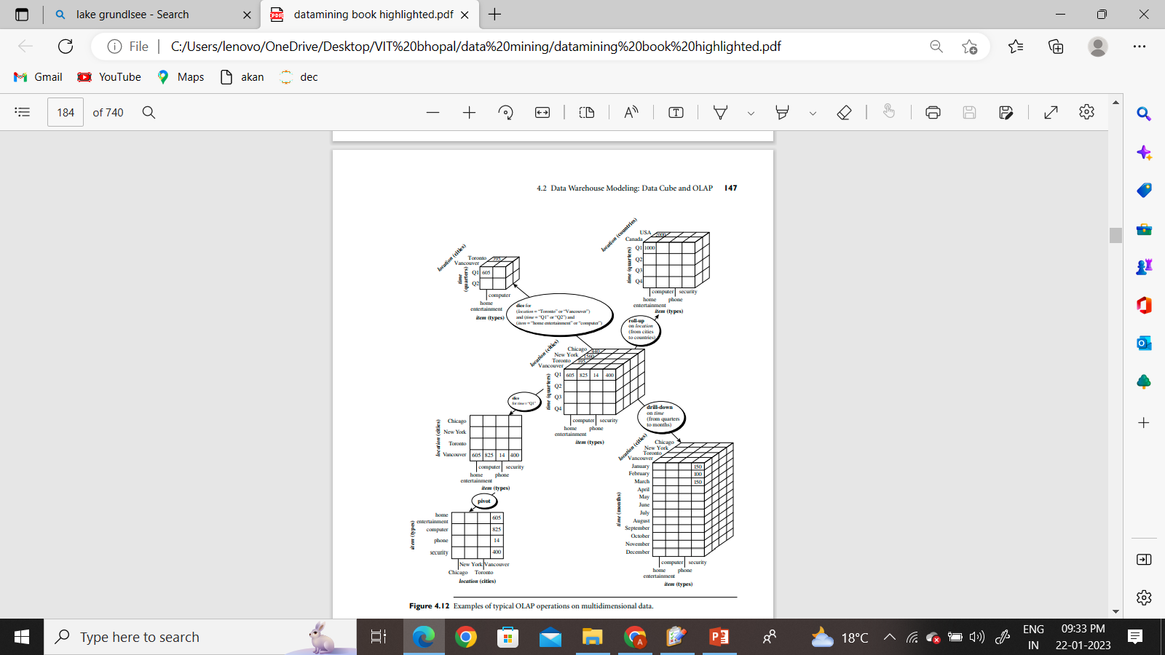
Different operations on multidimensional data

Slide 24
Roll-up:
The roll-up operation (also called the drill-up operation by some vendors) performs aggregation on a data cube, either by climbing up a concept hierarchy for a dimension or by dimension reduction. Figure 4.12 shows the result of a roll-up operation performed on the central cube by climbing up the concept hierarchy for location given in Figure 4.9. This hierarchy was defined as the total order “street < city < province or state < country.” The roll-up operation shown aggregates the data by ascending the location hierarchy from the level of city to the level of country. In other words, rather than grouping the data by city, the resulting cube groups the data by country.

Slide 25
Slice and dice: The slice operation performs a selection on one dimension of the given cube, resulting in a sub cube. The dice operation defines a sub cube by performing a selection on two or more dimensions.
Pivot (rotate): Pivot (also called rotate) is a visualization operation that rotates the data axes in view to provide an alternative data presentation

Slide 26
Drill-down
Drill-down is the reverse of roll-up. It navigates from less detailed data to more detailed data. Drill-down can be realized by either stepping down a concept hierarchy for a dimension or introducing additional dimensions. Figure 4.12 shows the result of a drill-down operation performed on the central cube by stepping down a concept hierarchy for time defined as “day < month < quarter < year.” Drill-down occurs by descending the time hierarchy from the level of quarter to the more detailed level of month. The resulting data cube details the total sales per month rather than summarizing them by quarter.

Slide 27
A Starnet Query Model
Starnet model consists of radial lines emanating from a central point, where each line represents a concept hierarchy for a dimension. Each abstraction level in the hierarchy is called a footprint. These represent the granularities available for use by OLAP operations such as drill-down and roll-up.
A starnet query model for the AllElectronics data warehouse is shown in Figure 4.13. This starnet consists of four radial lines, representing concept hierarchies for the dimensions location, customer, item, and time, respectively. Each line consists of footprints representing abstraction levels of the dimension. For example, the time line has four footprints: “day,” “month,” “quarter,” and “year.” A concept hierarchy may involve a single attribute (e.g., date for the time hierarchy) or several attributes (e.g., the concept hierarchy for location involves the attributes street, city, province or state, and country).

Slide 28
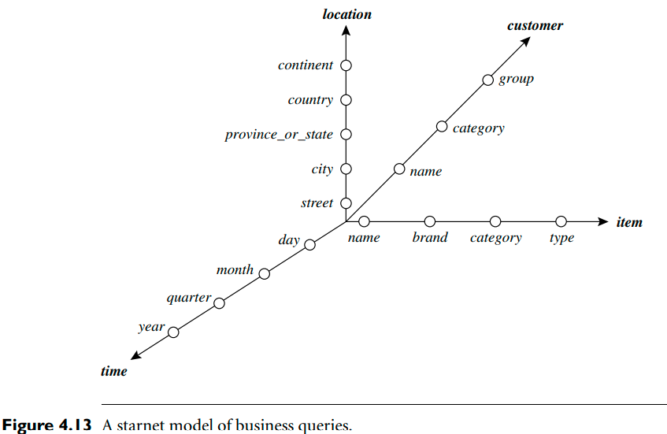
A Starnet Query Model contd..

Slide 29
Data cube dimension table fact table Star schema snowflake schema fact constellation schema galaxy schema Concept Hierarchy types of concept hierarchy slicing dicing roll up drill down pivot starNet
Now Familiar terms

Slide 30
Thank You

